Slide 1
Conjugate Coding
UT Austin Quantum Computing Collective 6:00 CST

Slide 2
The Birth of Quantum Information
** (From my limited perspective)

Slide 3
Fundamentals
Superposition (thank you @Will)
Polarization of Light
Measurement

Slide 4
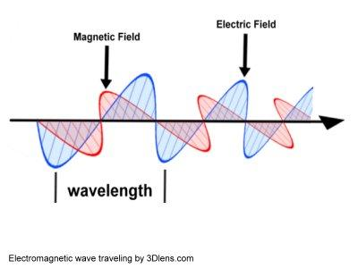
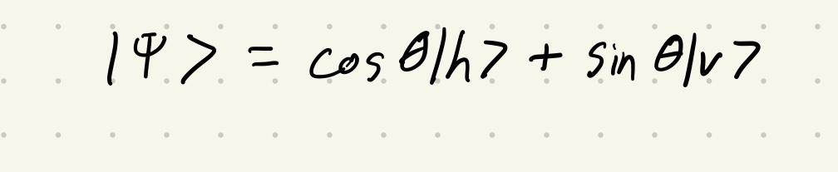
Polarization
Oversimplified explanation:
Transverse waves (light) are polarized
Polarization means we have a wave perpendicular to the main propagation.
- What does this mean for superposition?

Slide 5
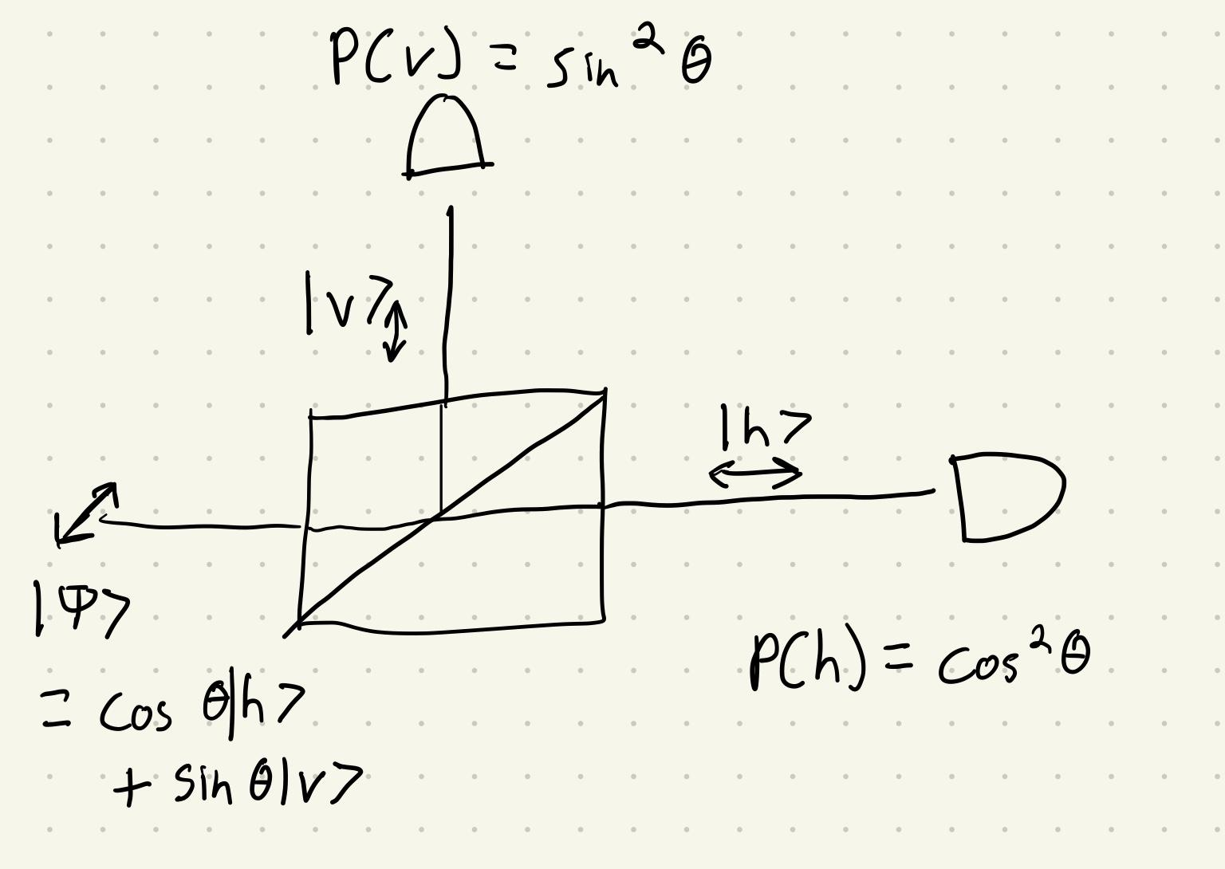
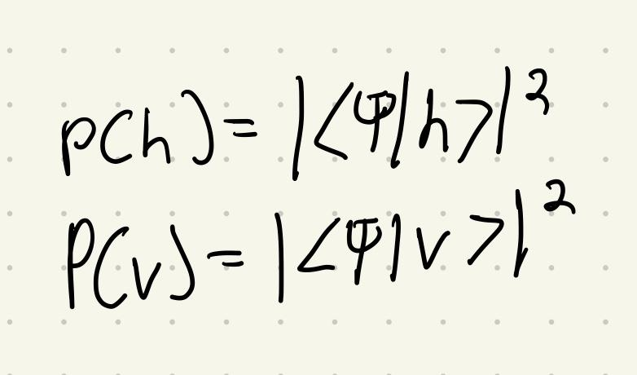
Depolarization (Measurement)
Splitting up these two waves is akin to measurement!
We only get to measure horizontal or vertical! ( or Up-diag, Down-diag)
No cloning theorem

Slide 6
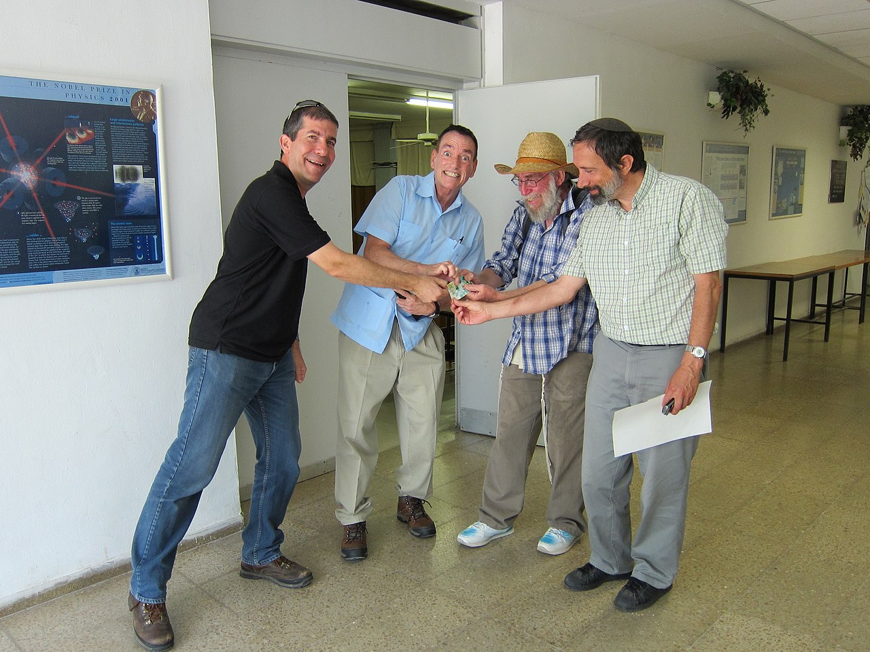
Overview
Stephen Wiesner
Developed in the late 1960s
Goal: A means for transmitting two messages either but not both of which may be received.
Rejected from publication (too ahead of its time?)

Slide 7
Cool so how do we do it?

Slide 8
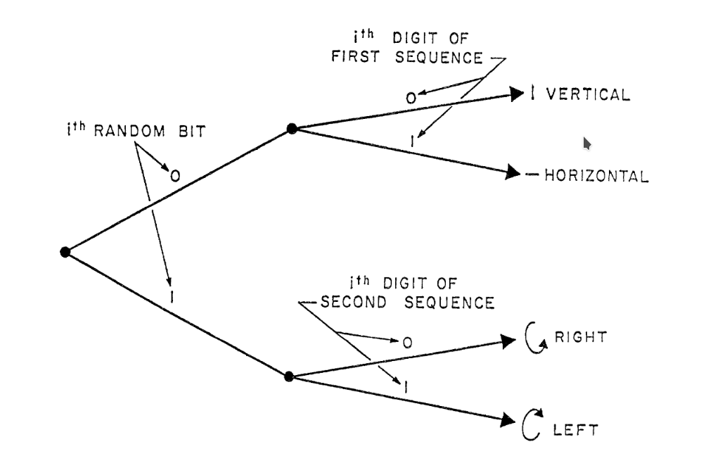
Sending the Messages
Grab a light polarizer
Convert messages to bitstreams
Find a medium for transporting message
Flip a coin, emit ith bit from message 1 or message 2
Polarize 45,-45 or 0,90 depending on ith bit of message chosen (set our theta)

Slide 9
Receiving the Messages
Set up a birefringent crystal or other depolarizing analyser
Depolarize to 45,-45 or 0,90 for full message of one but not both
If the linear polarization(0,90) of a photon is measured, all chance of measuring its circular polarization(45,-45) is lost
If we set up some mix of the two, we will just be getting jibberish
Measurement == Destroying Quantum State

Slide 10
Conclusion
Sets stage for secure quantum information distribution
QKD
BB84

